Slide 1
GymFlow
💳
Membership Plans
🏋️
Trainer Mgmt
Gym & Fitness Center Management System
📋
Workout Plans
📊
Admin Reports
React Frontend • Spring Boot Backend • MySQL Database
Built by a team of 11

Slide 2
Problem Statement & Solution
❌ The Problem
✅ Our Solution — GymFlow
Gym staff manage everything manually — paper registers, phone calls, and spreadsheets
A full-stack web application that digitises and automates all gym operations end-to-end
Members have no way to browse available trainers or view their workout plans online
Members can register, choose subscription plans, browse trainers, and view workout plans
Admins cannot assign trainers to members efficiently — it is done verbally or on paper
Admin dashboard lets admins assign trainers to members with one click and track all data
There is no centralised view of revenue, subscriptions, or attendance data
Platform reports provide live stats on revenue, subscriptions, and trainer workloads
Trainers cannot create or share structured workout plans with their members
Trainers can create personalised workout plans for each assigned member from their dashboard
No role-based access — any staff member can view or change any data
JWT-based role guards ensure Members, Trainers, and Admins only see their own data

Slide 3
Project Overview — What is GymFlow?
GymFlow is a full-stack Gym & Fitness Center Management System built with React, Spring Boot, and MySQL. It provides a single platform for three types of users — Members, Trainers, and Admins — each with their own role-specific dashboard and protected routes. The system covers the complete lifecycle of a gym member, from registration and subscription to trainer assignment, personalised workout plans, and fitness class booking.
👥
⚙️
📄
🖥️
👷
3
7
6
4
11
User Roles
Backend Services
Functional Req.
Frontend Modules
Team Members
Technology Stack
Frontend:
React 18 + Axios + React Context API
Backend:
Spring Boot 3.2 • Spring Data JPA • REST APIs
Database:
MySQL • Hibernate ORM • Auto DDL via JPA
Auth:
JWT Token • Role-Based Access Control (RBAC)

Slide 4
System Overview — Three User Roles
🧑‍💪
🛡️
🏋️
MEMBER
ADMIN
TRAINER
Register, Subscribe, Browse Trainers, View Workout Plans
Manage Platform, Assign Trainers, View Reports
Manage Profile, Create Workout Plans for Members
Architecture Stack
Frontend
React + Axios
Backend
Spring Boot
Database
MySQL
Auth
JWT Tokens

Slide 5
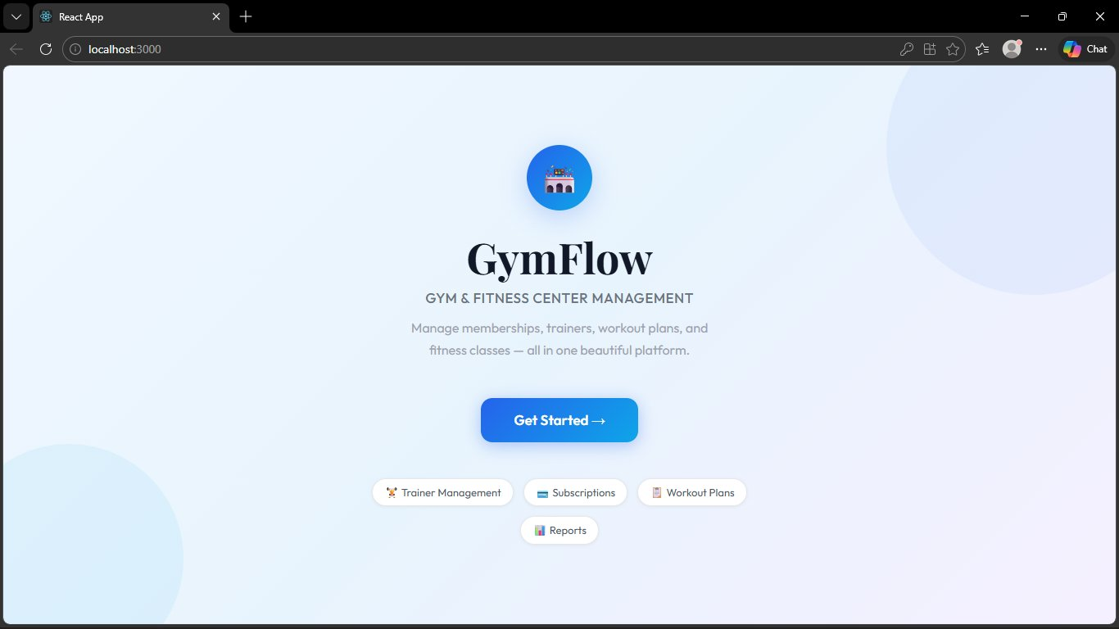
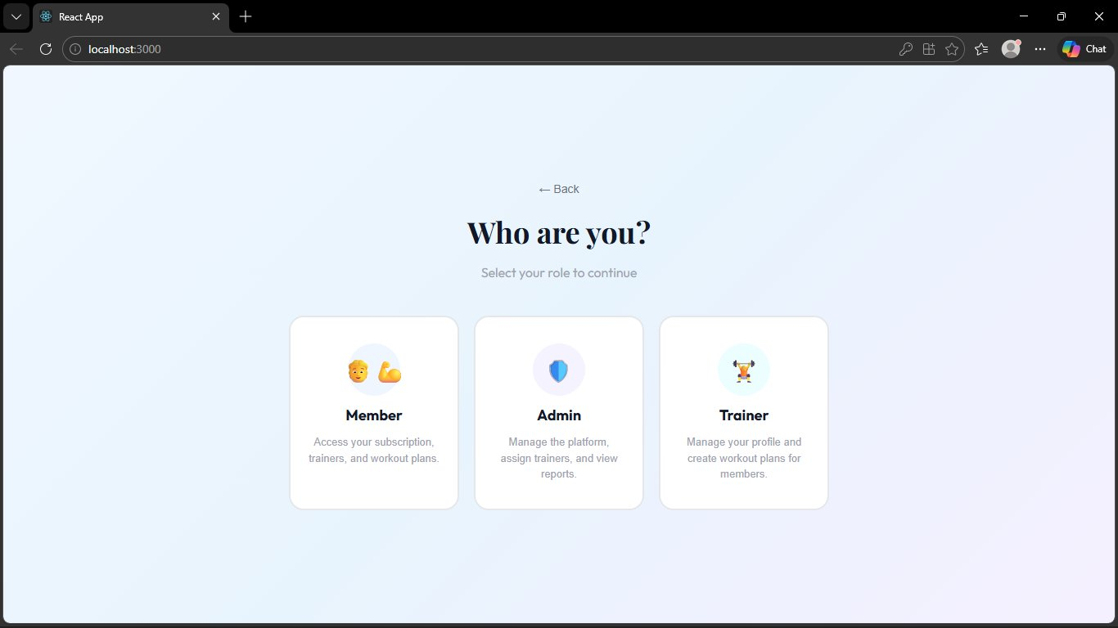
User Journey — Welcome & Role Selection
Welcome / Landing Page
Role Selection — Member / Admin / Trainer
Flow: Click "Get Started" → Select your Role → Login or Register as a new user
Demo credentials: Member → alice/pass | Trainer → bob/pass | Admin → admin/admin123

Slide 6
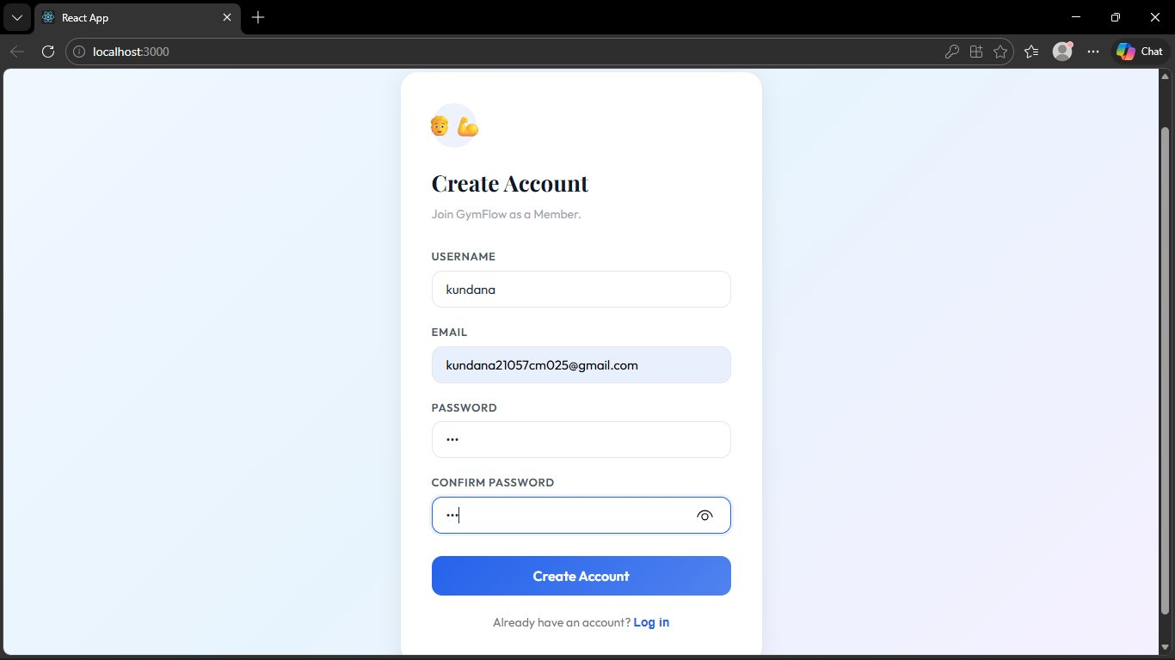
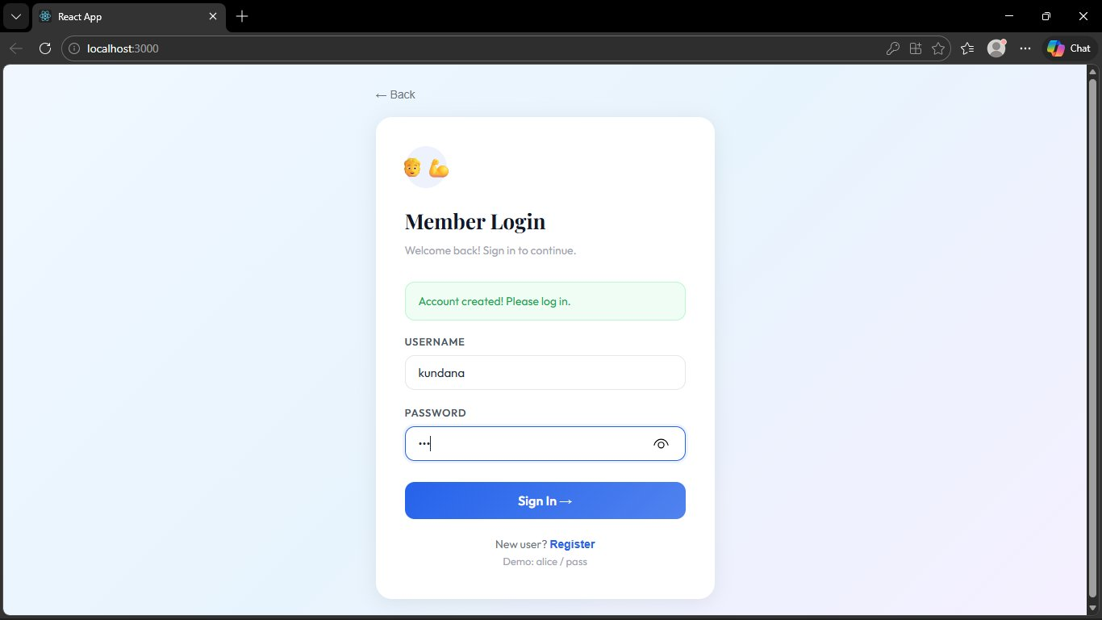
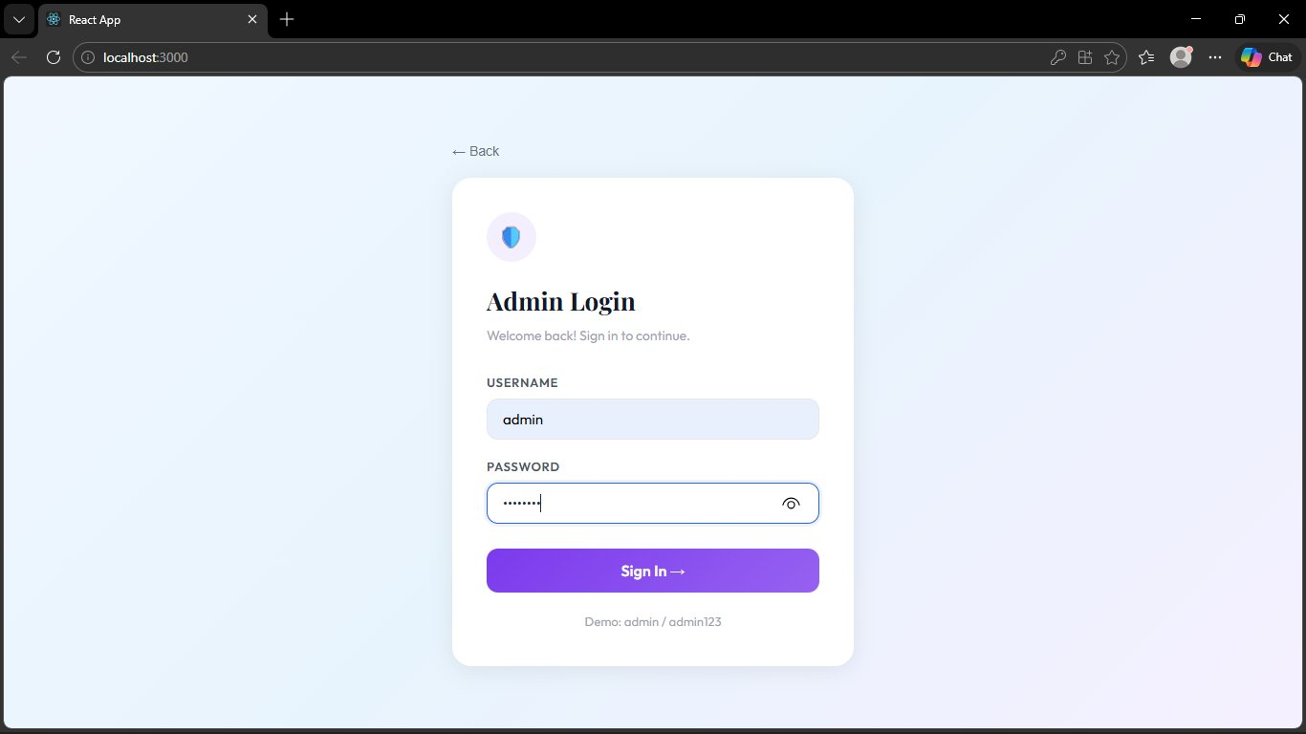
Authentication — Register & Login
Member Register
Member Login
Admin Login
How it works: User fills the form → Spring Boot validates credentials → JWT token issued → Role detected → Redirected to correct dashboard
Backend (FR-06): POST /api/user/register • POST /api/user/login • Returns { token, userId, username, role }

Slide 7
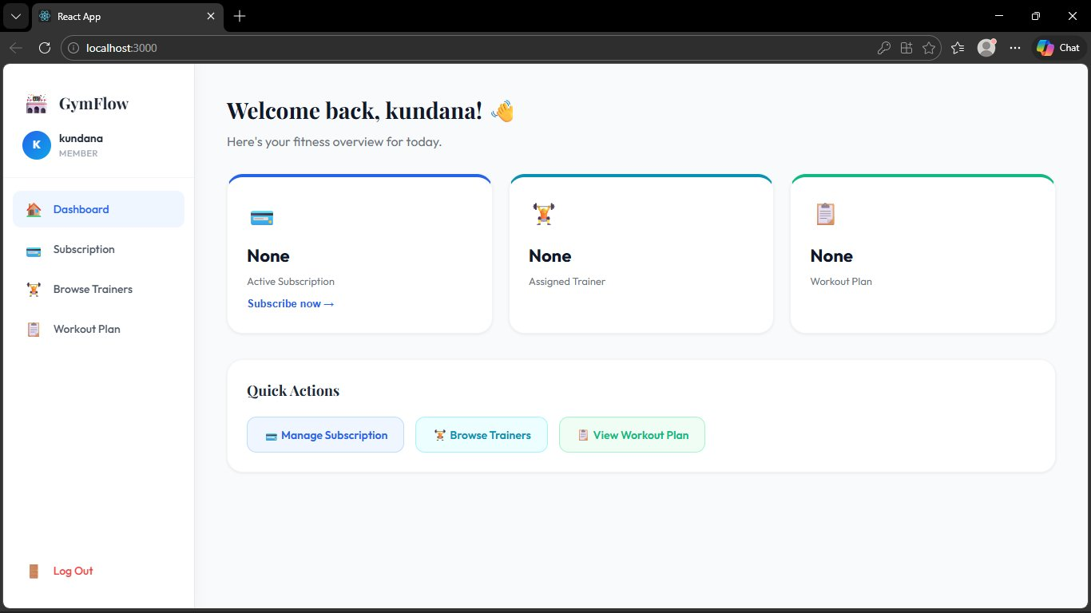
Member Dashboard — Overview
Dashboard Features
💳 Subscription status
🏋️ Assigned trainer
📋 Workout plan status
🚀 Quick action buttons
After login the member immediately sees their subscription plan, assigned trainer name and specialty, and their current workout plan — all in one glance.
FR-01 | FR-02 | FR-03

Slide 8
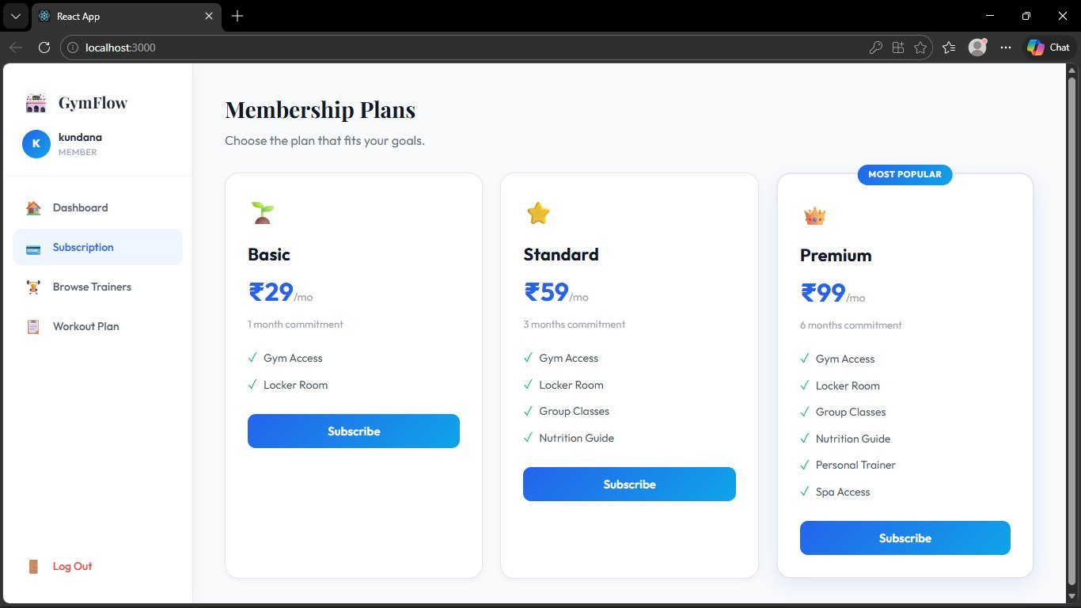
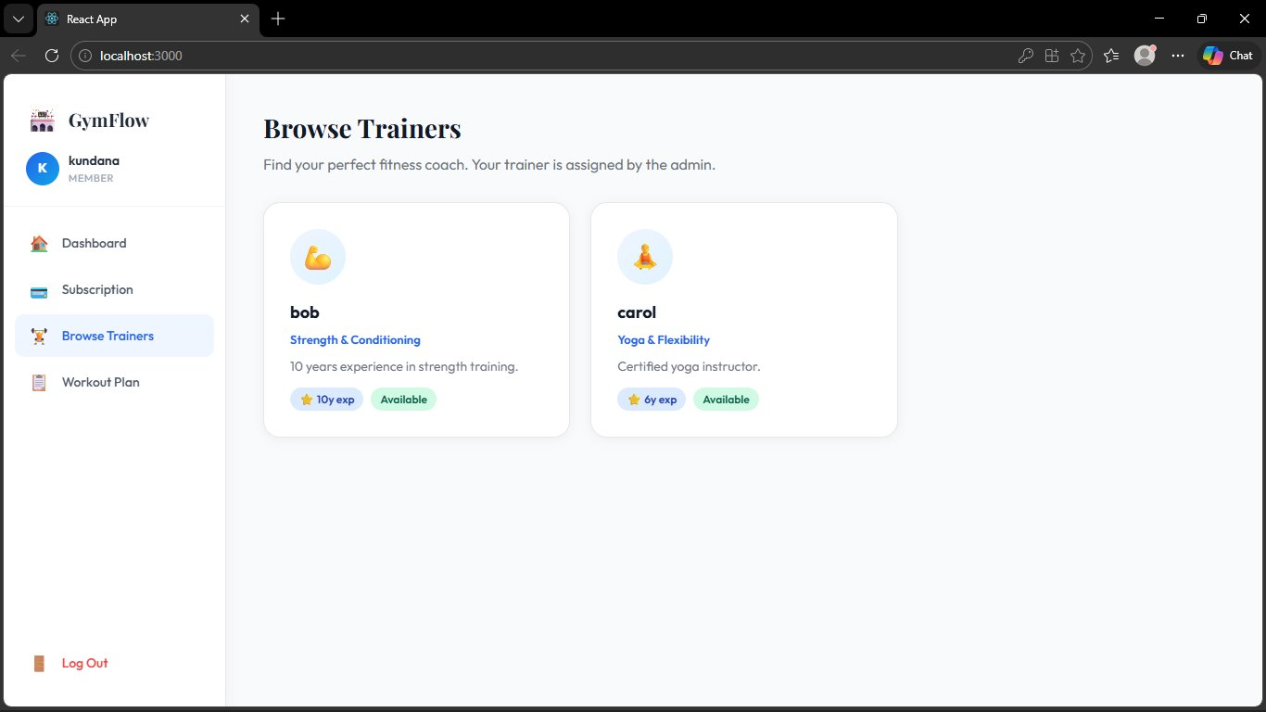
Member — Subscription Plans & Browse Trainers
Subscription — Basic / Standard / Premium
Browse Trainers — Filter by Specialty
Members choose from 3 tiered plans (Basic ₹29, Standard ₹59, Premium ₹99). They can also browse all available trainers, filtered by specialty, and see who has been assigned to them by the admin.
FR-01: POST /api/member/subscribe • FR-02: GET /api/member/trainers

Slide 9
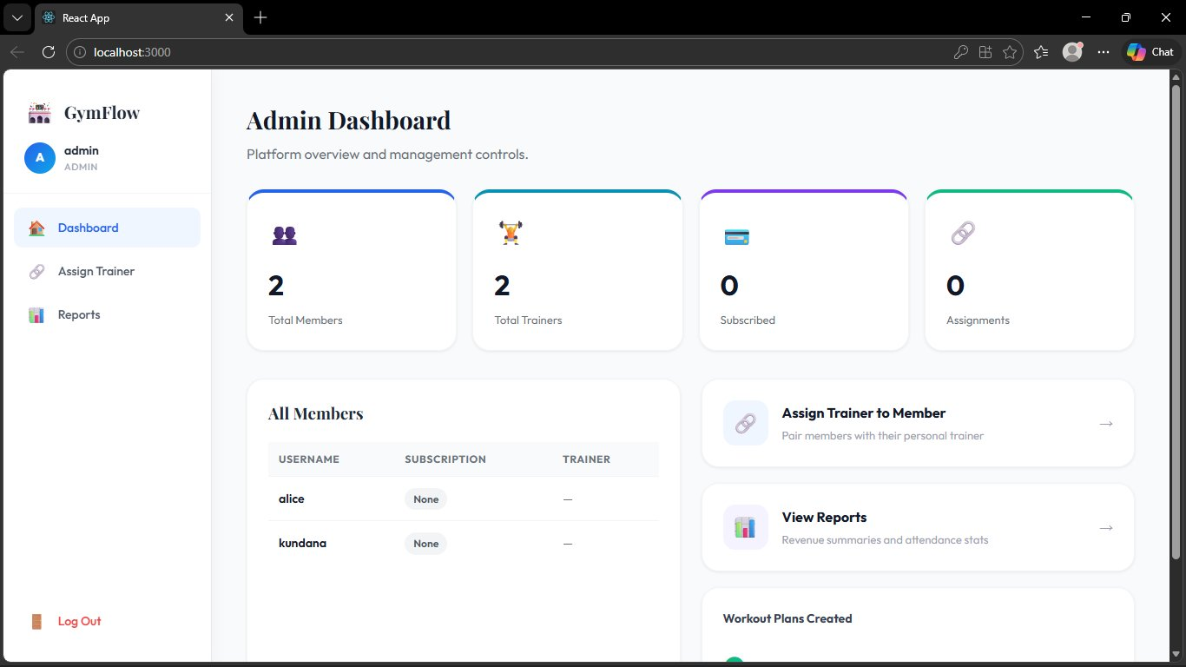
Admin Dashboard — Platform Overview
Live Stats
👥
2 Members
🏋️
2 Trainers
💳
Subscriptions
🔗
Assignments
The admin gets a bird's eye view of the entire platform — total members, trainer counts, subscription statuses, and all current trainer-member assignments — all in one place.
FR-05 | FR-06: GET /api/admin/members • GET /api/admin/trainers

Slide 10
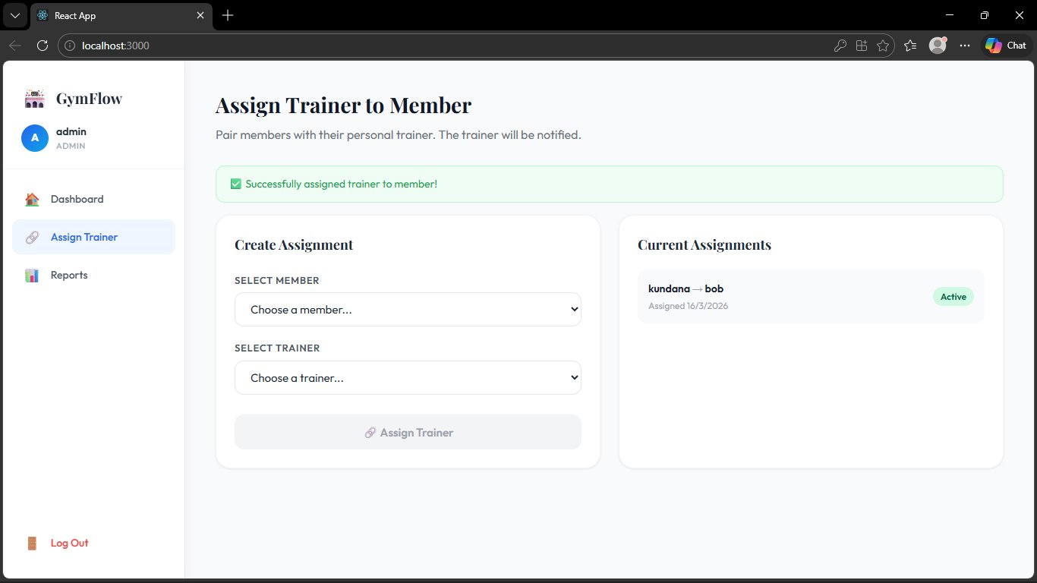
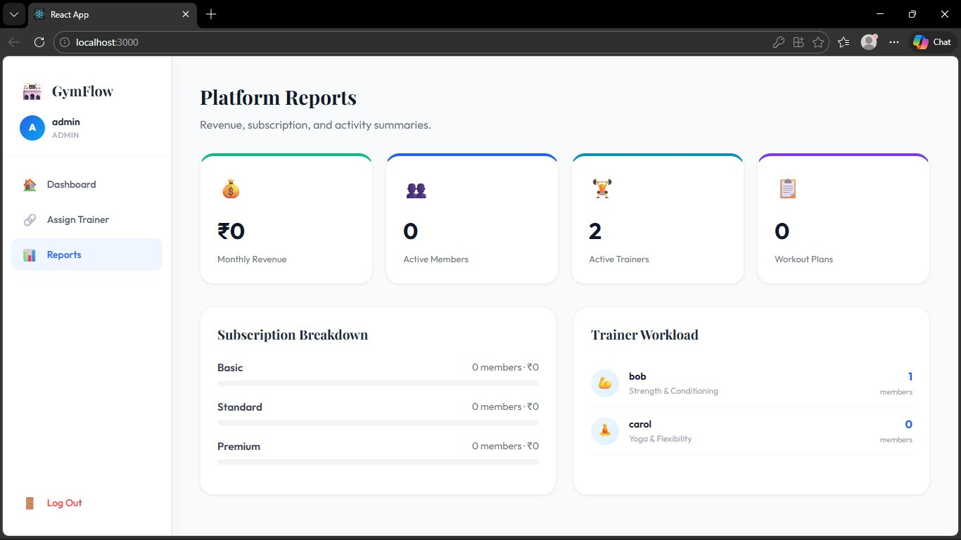
Admin — Assign Trainer & Platform Reports
Assign Trainer to Member
Revenue, Subscription & Attendance Reports
The admin selects any member and any available trainer and pairs them instantly. The assignment is then visible to the trainer, enabling them to create a workout plan. Reports show monthly revenue, subscription breakdown by plan, and trainer workload.
FR-02: POST /api/admin/assign-trainer • FR-05: GET /api/admin/reports

Slide 11
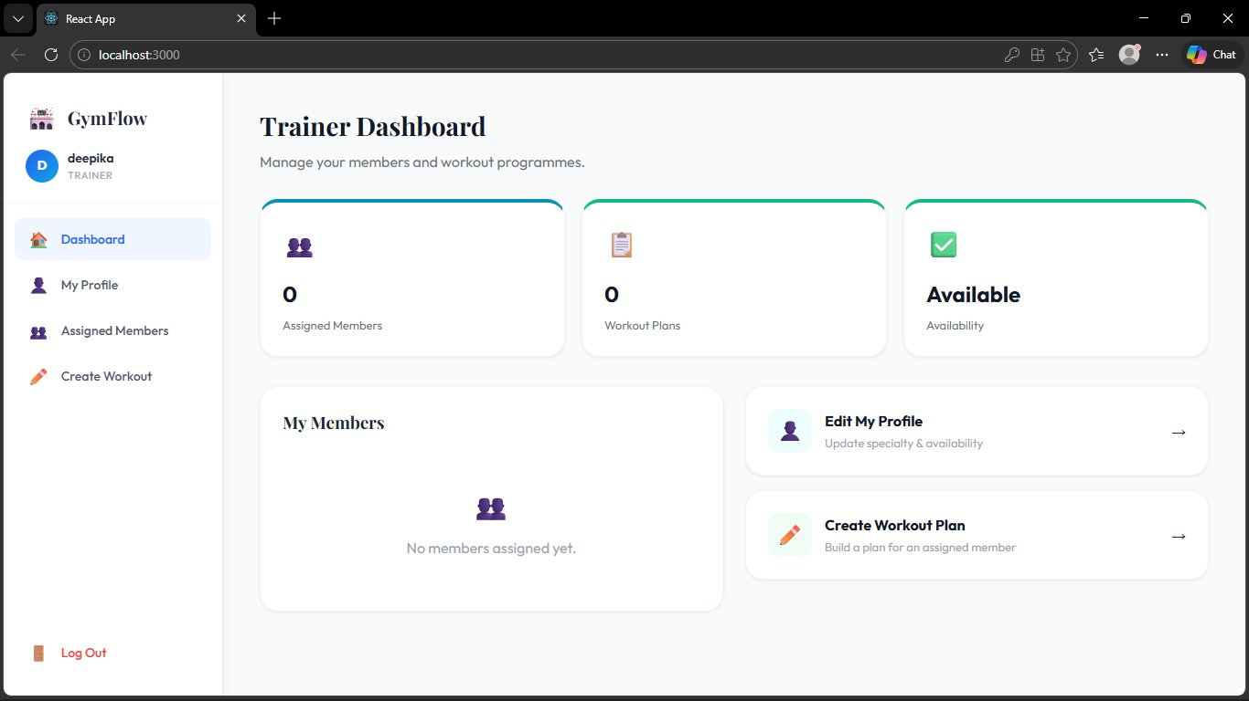
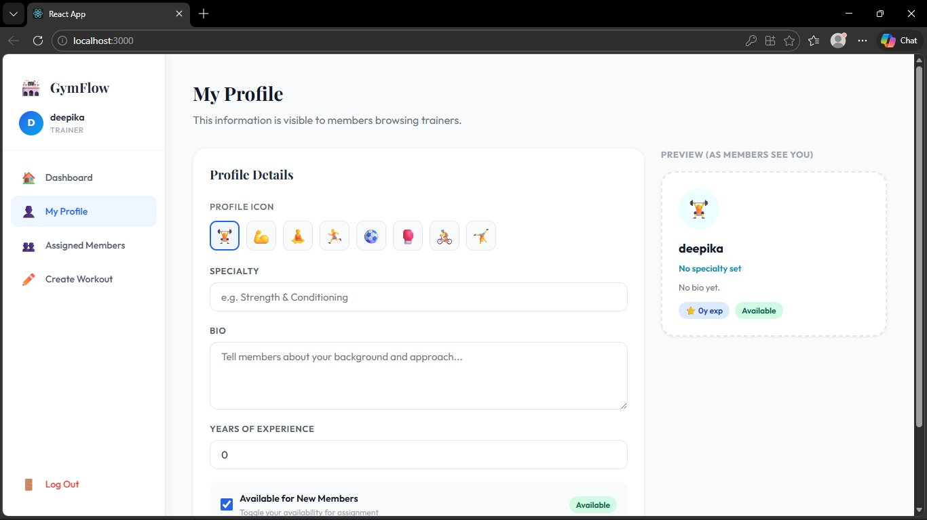
Trainer Dashboard — Profile & Members
Trainer Dashboard — Stats & Members
Profile Editor — Visible to Members Browsing Trainers
Trainers can update their specialty, bio, years of experience, and toggle their availability. This profile is displayed live in the Browse Trainers section so members always see up-to-date information.
FR-02: POST /api/trainer/profile • PUT /api/trainer/availability • GET /api/member/trainers

Slide 12
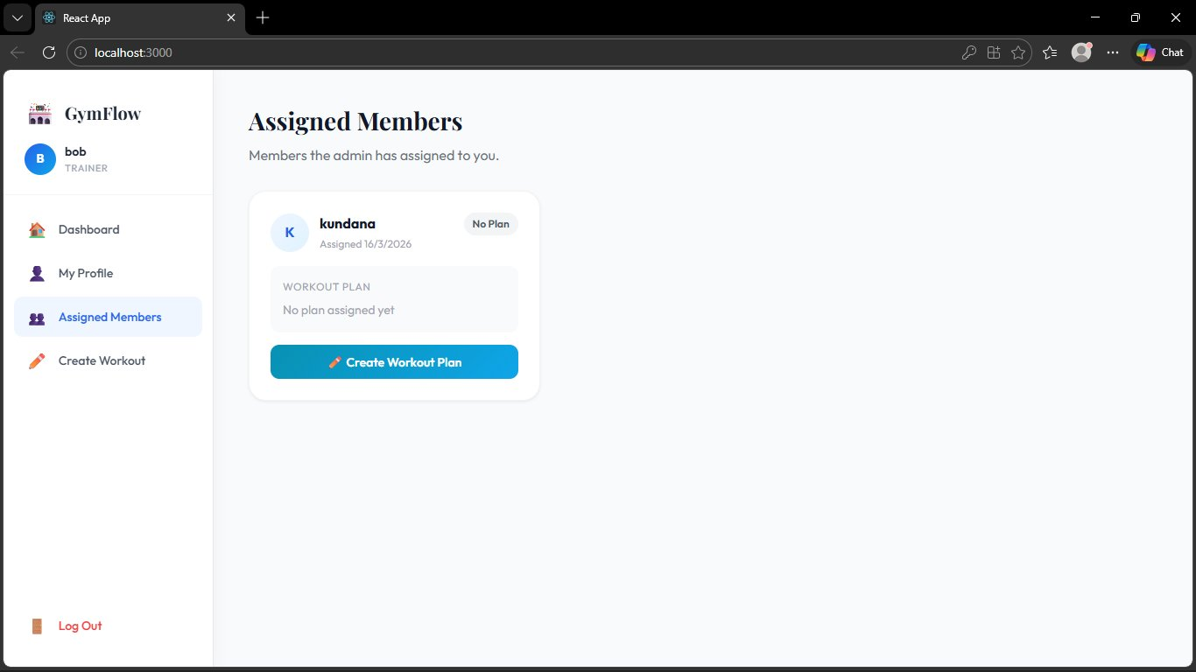
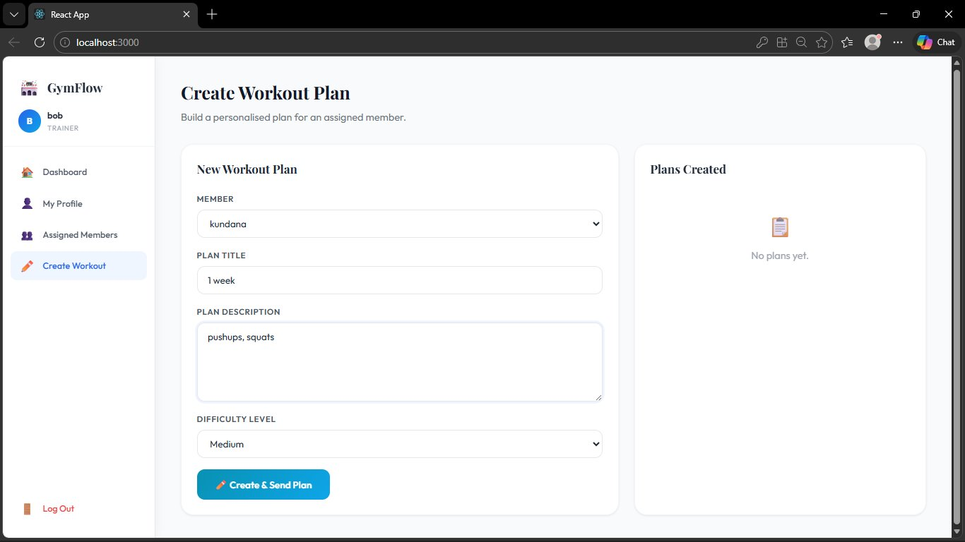
Trainer — Assigned Members & Create Workout Plans
Assigned Members — kundana → bob (Active)
Create Workout Plan — Title, Description, Difficulty
Once the admin assigns a member, the trainer sees them in the Assigned Members list. The trainer then selects the member, fills in the plan title, description, and difficulty level, and clicks Create & Send to push the plan to the member.
FR-03: POST /api/trainer/workout-plan • Validates trainer is assigned to member before allowing creation

Slide 13
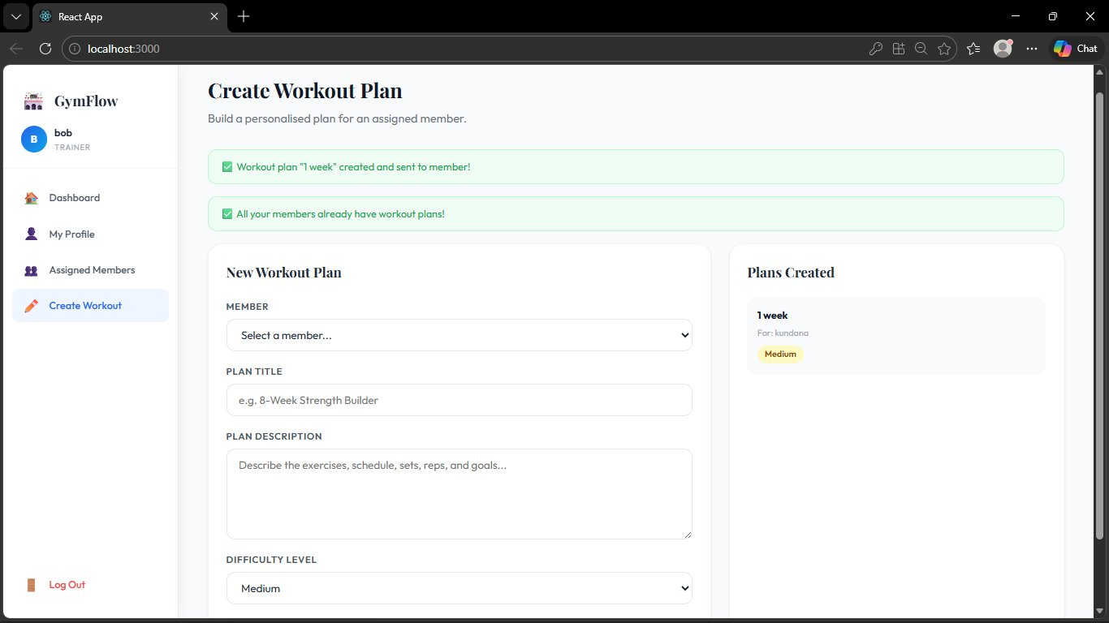
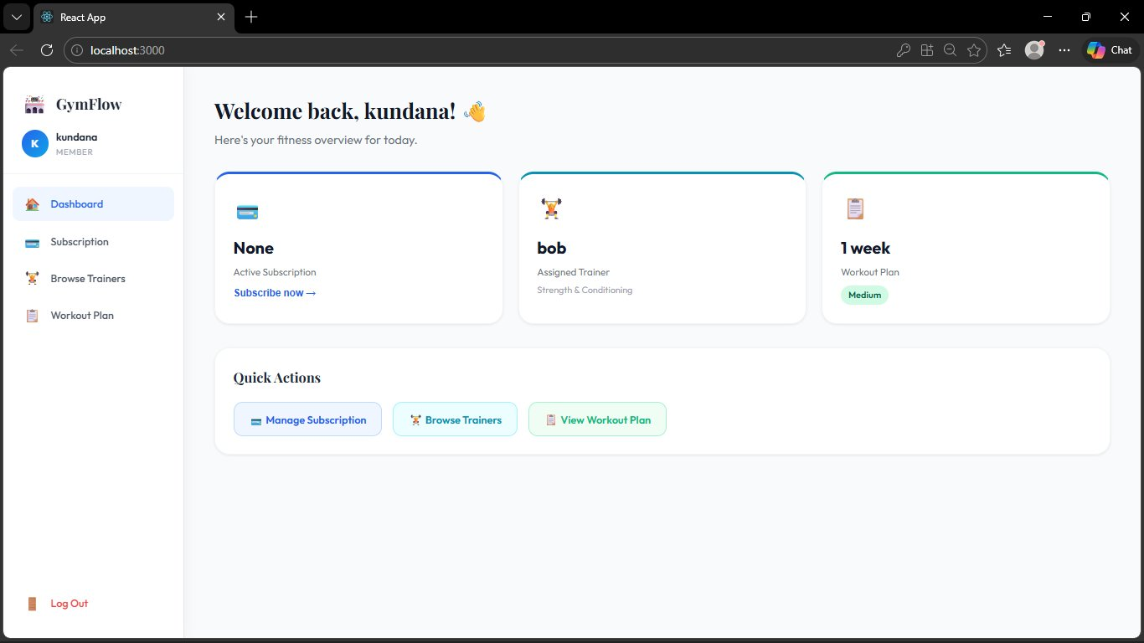
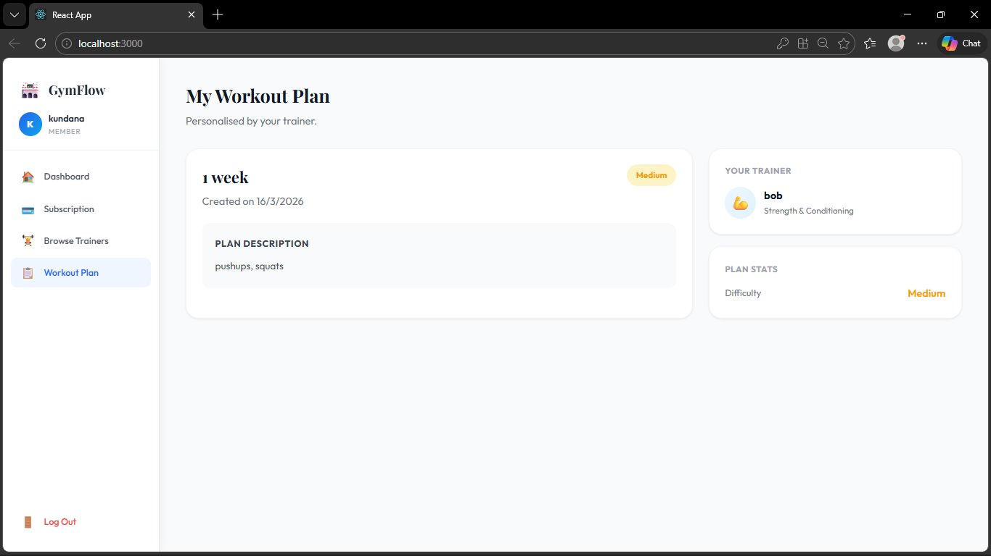
Workout Plan — Full End-to-End Flow
Trainer Fills Form — Member, Title, Description, Difficulty
Success — Plan sent, all members now have plans
Member Dashboard — Trainer (bob) and Plan (1 week) visible
Member Views Full Plan — pushups, squats, Medium

Slide 14
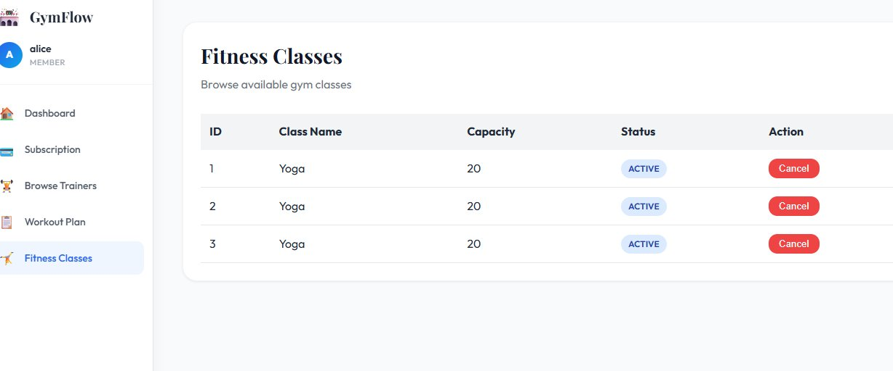
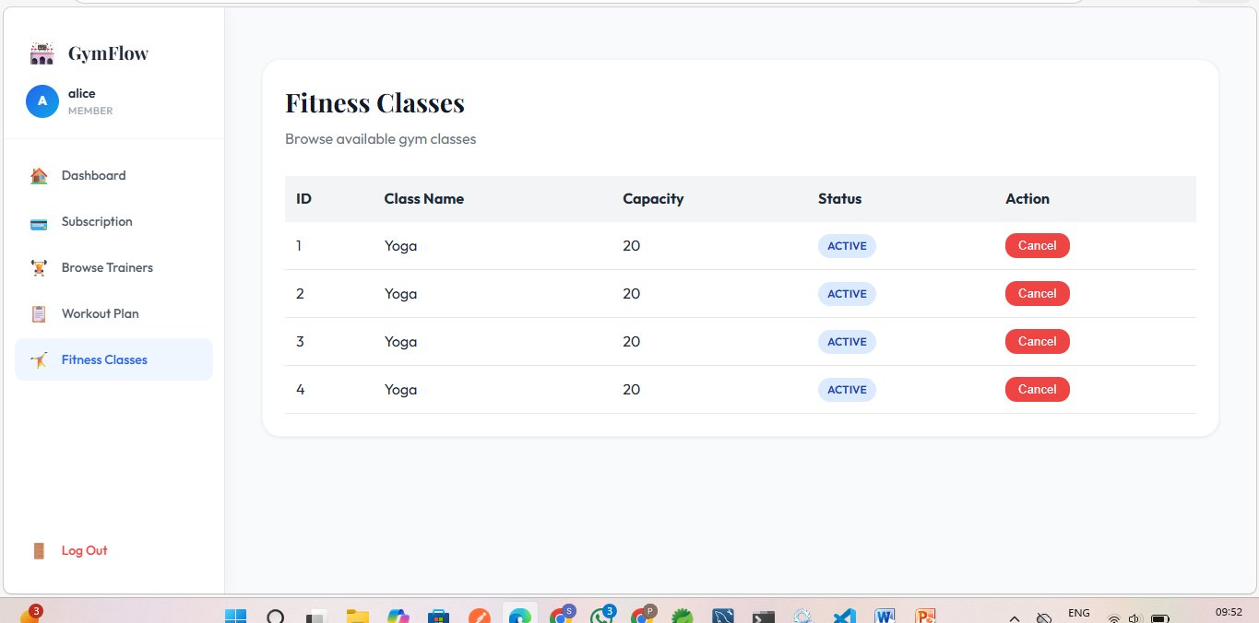
Member — Fitness Classes
Fitness Classes — Before adding (3 classes)
Fitness Classes — After adding (4 classes)
Members can view all available fitness classes from the Fitness Classes page. Each class shows its ID, name, capacity, and ACTIVE status. Members can cancel a booking using the Cancel button. After Admin adds a new class via POST /api/admin/class, it instantly appears in the list.
FR-04: GET /api/member/classes • Admin: POST /api/admin/class

Slide 15
Backend — Member 1: Auth & Security | Member 2: Membership
M1
Auth & Security (FR-06)
M2
Membership Plan (FR-01)
Package: com.gymflow.auth
Package: com.gymflow.membership
Entity: User (id, username, password, email, role)
Entity: MembershipPlan (id, planName, durationMonths,
Enum: Role { MEMBER, TRAINER, ADMIN }
price, features)
DTO: RegisterRequest, LoginRequest, LoginResponse
Entity: Subscription (id, member FK, plan FK,
UserRepository: findByUsername, existsByUsername,
startDate, endDate, subscriptionStatus)
existsByEmail, findAllByRole, countByRole
Enum: SubscriptionStatus { ACTIVE, EXPIRED, CANCELLED }
AuthService: register(), login(), loadUserByUsername()
MembershipPlanRepository: findByPlanName, findAll
JwtTokenProvider: generateToken(), validateToken(),
SubscriptionRepository: findByMemberId,
getUsernameFromToken()
countByPlanId, findByStatus
JwtTokenFilter: doFilterInternal() — runs every request
MembershipService: createPlan(), subscribeMember(),
SecurityConfig: permitAll /register /login,
getActiveSubscription(), getSubscriberCountByPlan()
hasRole ADMIN/MEMBER/TRAINER per route
POST /api/admin/plan → Admin creates plan
POST /api/user/register → 201 Created
POST /api/member/subscribe → Member subscribes
POST /api/user/login → 200 + JWT token
GET /api/member/subscription→ View active plan

Slide 16
Backend — Member 3: Trainer Profile | Member 4: Workout Plans
M3
Trainer Profile (FR-02)
M4
Workout Plans (FR-03)
Package: com.gymflow.trainer
Package: com.gymflow.workout
Entity: Trainer (id, user FK, specialty, bio,
Entity: WorkoutPlan (id, title, description,
yearsExperience, available)
difficulty, trainer FK, member FK, createdAt)
TrainerRepository: findByUserId, findByAvailableTrue,
Enum: Difficulty { EASY, MEDIUM, HARD }
findBySpecialtyContaining
WorkoutPlanRepository: findByMemberId,
TrainerService: createOrUpdateProfile(),
findByTrainerId, findByTrainerIdAndMemberId
getAvailableTrainers(specialtyFilter),
WorkoutPlanService: createWorkoutPlan(),
toggleAvailability(), getTrainerById()
updateWorkoutPlan(), getPlansByMember(),
getAllTrainers() ← called by M7 Admin
getPlansByTrainer()
POST /api/trainer/profile → Create/update profile
⚠ Validates via M5.isAssigned() before creating
GET /api/member/trainers → Browse available
POST /api/trainer/workout-plan → Create plan
PUT /api/trainer/availability → Toggle on/off
GET /api/member/workout-plans → Member views
PUT /api/trainer/workout-plan/{id} → Update
GET /api/trainers/{id} → Get data by Id
DELETE /api/trainers/{id} → Delete data by Id

Slide 17
Backend — Member 5: Trainer Assignment | Member 7: Admin Reports
M5
Trainer Assignment (FR-02/03)
M7
Admin Reports (FR-05/06)
Package: com.gymflow.assignment
Package: com.gymflow.admin (NO entities)
Entity: TrainerAssignment (id, member FK, trainer FK,
DTO: ReportSummary (totalMembers, totalTrainers,
assignedDate, assignmentStatus)
activeSubscriptions, totalRevenue,
Enum: AssignmentStatus { ACTIVE, COMPLETED, CANCELLED }
totalWorkoutPlans, totalClassBookings)
TrainerAssignmentRepository: findByMemberId,
AdminReportDao: Injects repositories from M1-M5
findByTrainerId, countByTrainerId
getAllMembersWithDetails()
TrainerAssignmentService: assignTrainer(),
getAllTrainersWithCounts()
getMembersByTrainer(), getTrainerByMember(),
generateReportSummary()
isAssigned() ← CALLED BY M4 to validate
AdminReportService: aggregates all data
getAssignmentCountByTrainer() ← used by M7
GET /api/admin/members → Members + subscription
POST /api/admin/assign-trainer → Admin assigns
GET /api/admin/trainers → Trainers + counts
GET /api/trainer/members → Trainer views
GET /api/admin/reports → Full platform report
GET /api/member/trainer → Member views
GET /api/admin/plans → Plans + subscriber count

Slide 18
Backend — Member 6: Fitness Classes
M6
Fitness Classes (FR-04)
UI
Member Fitness Classes View
Package: com.gymflow.fitnessclass
Members can browse all available fitness classes
Entity: FitnessClass (id, className, capacity,
created by Admin. Each class shows ID, name,
classStatus)
capacity, and status. Members can cancel their
Enum: ClassStatus { ACTIVE, CANCELLED }
booking using the Cancel button (sets status
FitnessClassRepository: findAll,
to CANCELLED). Admin creates new classes via
findById, findByClassStatus
POST /api/admin/class with className,
FitnessClassService: createClass(),
trainerName, and capacity. On creation the
getAllClasses(), cancelClass(),
class is returned with id and null fields for
getClassById()
schedule and trainerId (set later by admin).
FitnessClassController: REST endpoints
GET /api/member/classes → 200 OK (list)
POST /api/admin/class → Admin creates
POST /api/admin/class → 200 OK (object)
GET /api/member/classes → Member views all
Response: { id, className, capacity,
PUT /api/admin/class/{id}/cancel → Cancel
classStatus, schedule, trainerId }

Slide 19
Backend Dependency Map
How the 7 backend services depend on each other
M1 — Auth (User entity)
Referenced by ALL members (M2–M7) as Foreign Key in their entities
M3 — Trainer Profile
Trainer availability checked by M5 before allowing trainer assignment
M5 — Trainer Assignment
isAssigned() called by M4 before a trainer can create a workout plan
M2 — Membership
getSubscriberCountByPlan() consumed by M7 for revenue reports
M5 — Trainer Assignment
getAssignmentCountByTrainer() consumed by M7 for workload reports
M7 — Admin Reports
Reads and aggregates data from M1, M2, M3, M4, M5 repositories
Build Order: M1 → M2 & M3 → M4 & M5 → M7

Slide 20
🏟️
GymFlow
Thank You!
React
Spring Boot
MySQL
JWT
REST APIs
Case Study 15 | Group of 11 | Full Stack Web Application

